Slide 1
Patterns are Roles
What patterns are and what not…

Slide 2
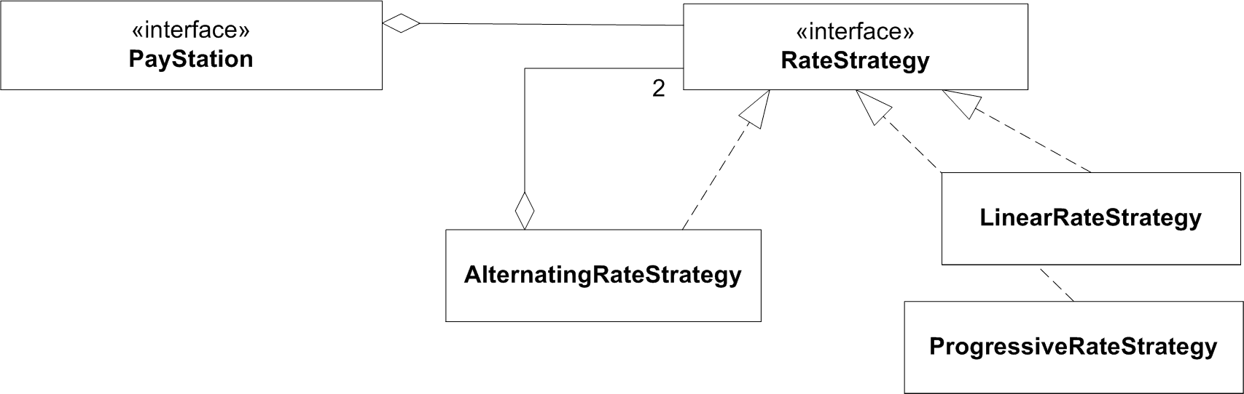
Let us compare this…
© Henrik Bærbak Christensen

Slide 3
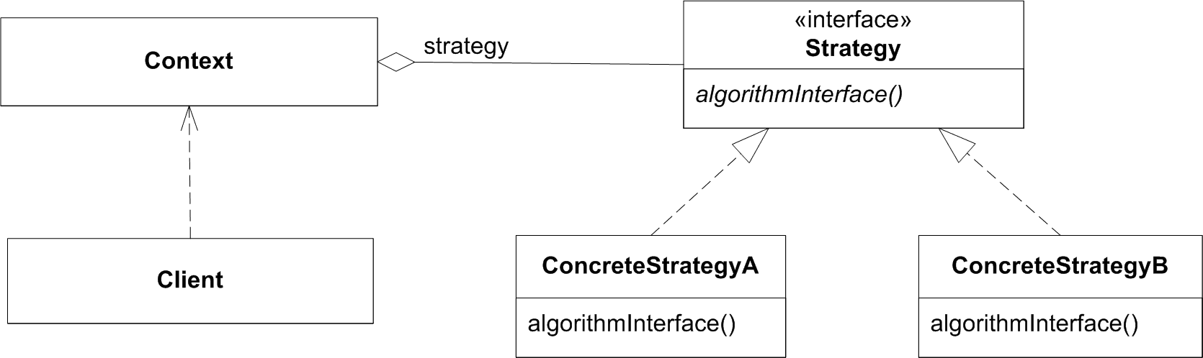
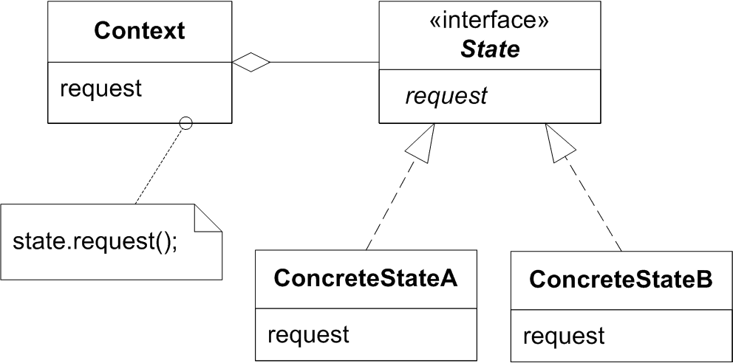
… with these two!
If these diagrams are correct, then something is wrong
One interface named State, one named Strategy...
© Henrik Bærbak Christensen

Slide 4
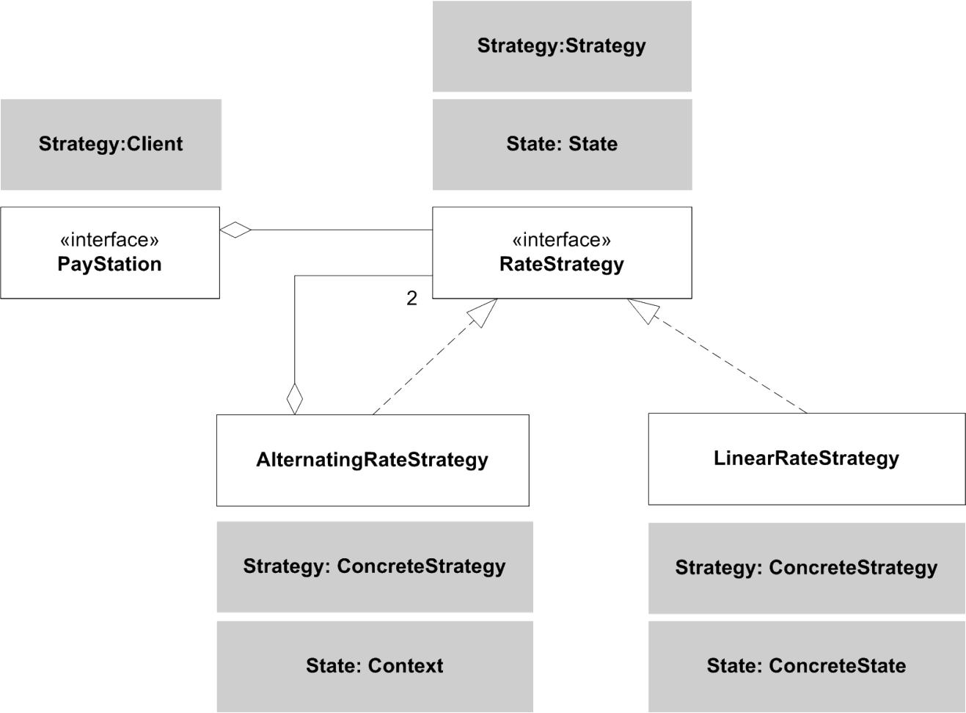
But…
UML diagrams cannot express roles – and patterns express roles, not classes!
© Henrik Bærbak Christensen

Slide 5



Revisiting
Team leader
rate calculation request
Rate Policy Expert
Linear
2.delegate to expert
1. check clock
Rate Policy Expert
Progressive
© Henrik Bærbak Christensen

Slide 6
The Team Leader
The AlternatingRateStrategy instance
  calculates rates = Concrete Strategy
  changes behaviour depending on = Context
The same object plays roles in two patterns!
Rate Policy Expert
Alternating rates
Context for state changes
© Henrik Bærbak Christensen

Slide 7
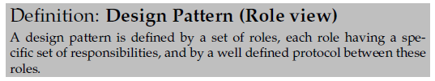
Summary
The essence of design patterns is at a higher level of abstraction than what you may see in e.g. UML class diagrams.
  You are not restricted by naming, method naming, classes - only by the roles and the protocol !
  often a single abstraction plays multiple roles !
© Henrik Bærbak Christensen

